Slide 1
CAPSTONE PROJECT
EMPLOYEE SALARY PREDICTION USING GRADIENT-BOOSTING CLASSIFIER
Presented By:
Name: Vaishnavi Agrawal
College Name: Thapar Institute of Engineering and Technology
Department: Electrical and Computer
AICTE Student ID: STU682db93a959511747827002

Slide 2
OUTLINE
Problem Statement
System Development Approach
Algorithm & Deployment (Step by Step Procedure)
Result
Conclusion
References

Slide 3
PROBLEM STATEMENT
The Employee Salary Prediction project builds an end‑to‑end machine learning pipeline to forecast salaries based on factors such as work experience, education level, job role, geographic location, and industry.
We ingested a real‑world HR dataset, handled missing values, and applied categorical encoding and numerical scaling during data preprocessing.
Feature engineering steps included deriving tenure buckets, one‑hot encoding of job titles and education categories, and normalizing continuous variables.
Regression algorithms Linear Regression and Random Forest Regressor were trained and fine‑tuned; performance was evaluated using MAE, RMSE, and R² metrics.
Insightful visualizations (correlation heatmaps, feature importance plots) were created with Matplotlib and Seaborn to interpret model behavior.
Deployed and experimented within IBM Watson Studio, demonstrating how data‑driven models can empower HR teams to make informed compensation and hiring decisions

Slide 4
SYSTEM APPROACH
System requirements
OS: Windows 10/11, macOS, or any Linux-based system
Python Version: Python 3.9 or higher (recommended: Python 3.10+)
RAM: Minimum 4 GB (8 GB or more recommended for faster model training)
Disk Space: ~500 MB (including dataset, model files, and dependencies)
Library required to build the model
pandas Numpy scikit-learn joblib
streamlit matplotlib seaborn

Slide 5
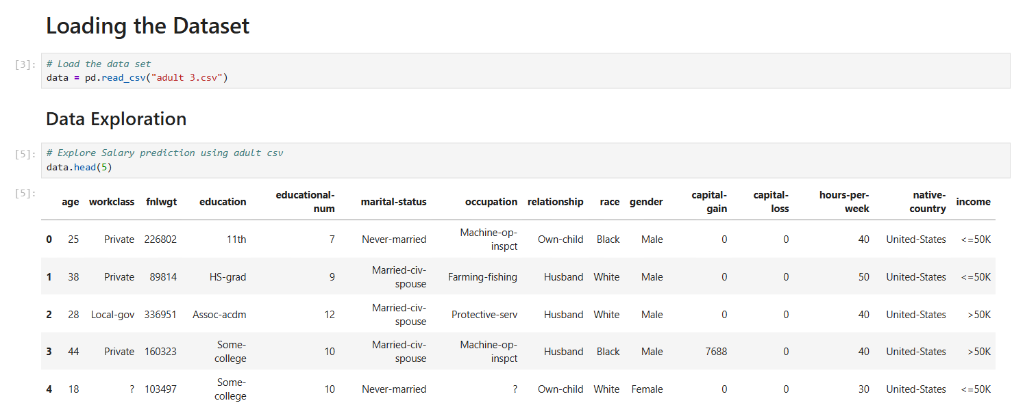
ALGORITHM & DEPLOYMENT
1. Data collection
Loaded the Adult Income dataset with demographic and job‑related features for salary prediction.
Loading Dataset

Slide 6
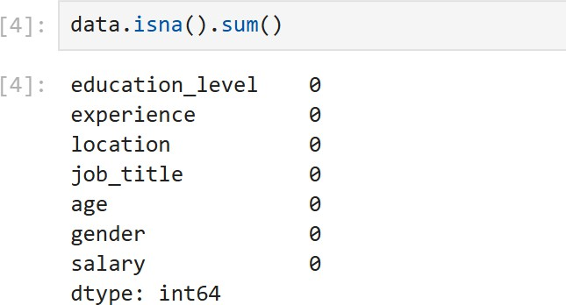
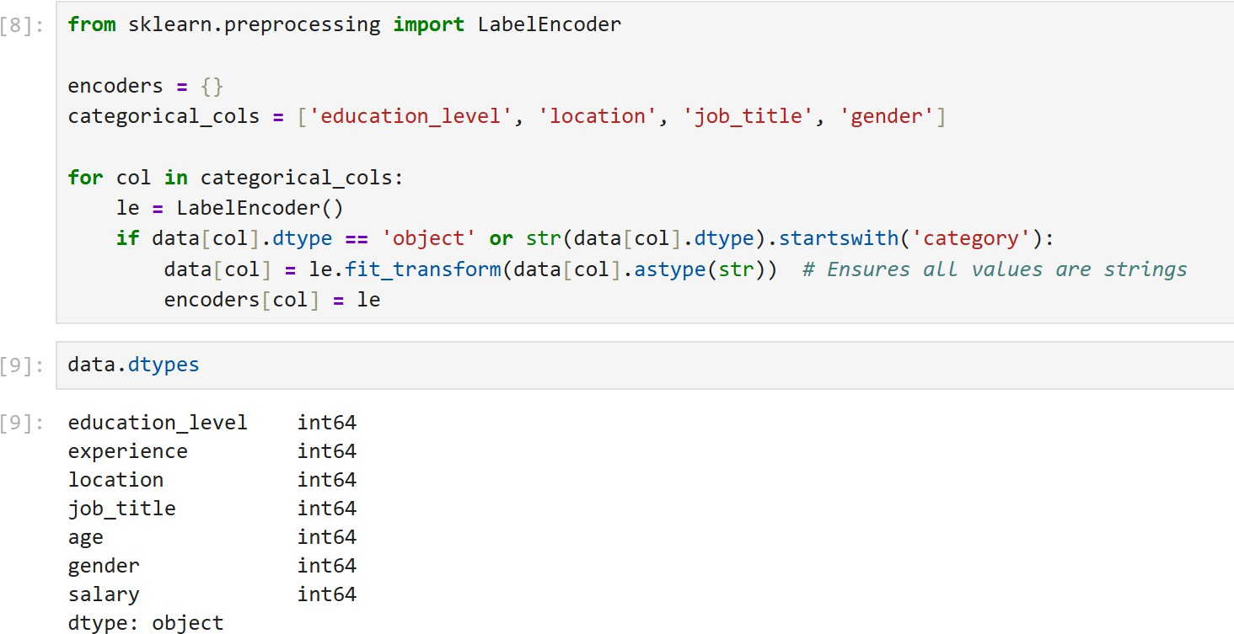
ALGORITHM & DEPLOYMENT
2. Data Preprocessing
Cleaned the data: handled missing values and identified/remediated outliers (IQR/boxplot checks).
Encoded categories: transformed work class, education, occupation, gender, etc. to numeric form (label/one‑hot encoding).
Engineered features: derived signals from experience and hours‑per‑week (e.g., buckets/normalized values) to boost model performance.
.

Slide 7
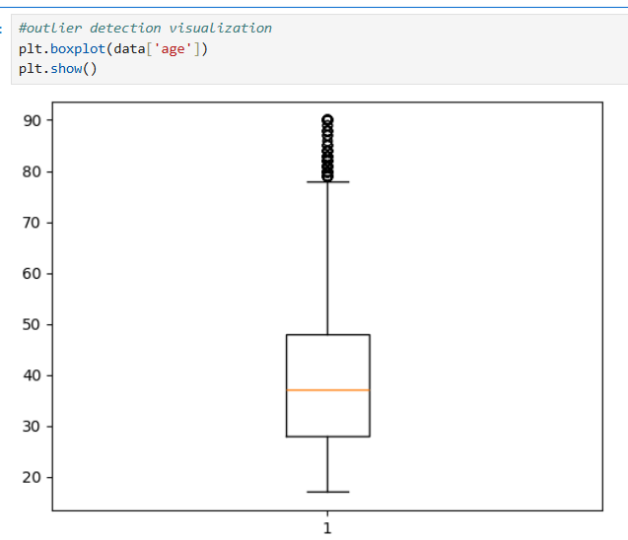
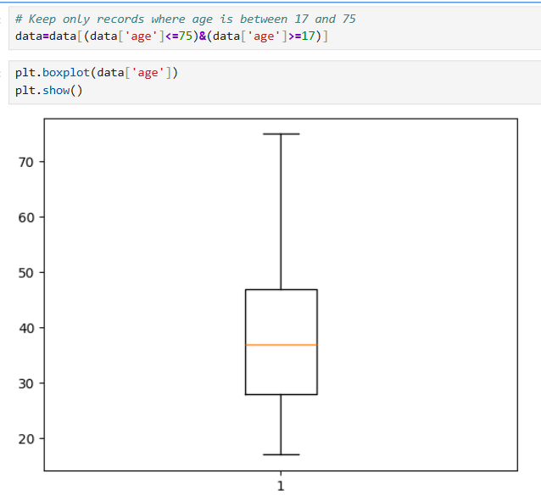
ALGORITHM & DEPLOYMENT
3. Outlier Detection & Removal
Performed outlier detection on the age feature using boxplots and removed rows with values outside the IQR whisker bounds (e.g., <17 or >70) .

Slide 8
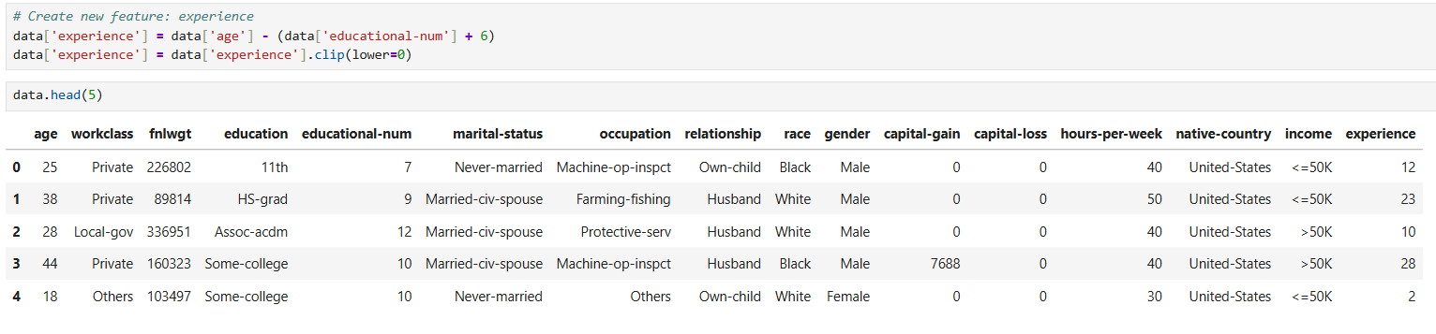
ALGORITHM & DEPLOYMENT
4. Feature Engineering
Create a new features called experience by estimating it as the difference between age and years of education plus 6 (assume education starts at age 6).
To ensure realistic values, negative experience values were clipped.

Slide 9
ALGORITHM & DEPLOYMENT
5. Label Encoding
Applied Label Encoder to concert categorical features into numeric format, making them compatible with machine learning models.
Each category was mapped to a unique integer to enable efficient model training.
6. Prepare Features and Target
Dropped less relevant columns like ‘fnlwgt’, ‘educational-num’ , and others to simplify the model and reduced noise.
Split the dataset into features (x) and target (y) , with ‘income’ as the target for prediction.
7. Apply Min-Max Scalar
Applied Min-Max Scaling to normalize features values between 0 and 1 .
This ensure that all features contribute equally model training and helps improve the performance of distance-based models.

Slide 10
ALGORITHM & DEPLOYMENT
8. Model Building
Split the dataset into training and testing sets.
Evaluated multiple classification algorithms: Logistic Regression, K-Nearest Neighbors, SVM, Random Forest , Gradient-Boosting.
9. Model Evaluation
Compared models using accuracy, precision, recall, F1-score; selected best-performing model.
Visualized evaluation results with confusion matrix and classification report..

Slide 11
ALGORITHM & DEPLOYMENT
10. Model Serialization
Saved the trained model using job-lib for further deployment.
Save the Clean dataset (Cleaned_data.csv).
11. Deployment with Streamlit
Built an interactive UI in Stream-lit for real-time salary prediction.
Allowed user data input through dropdowns and sliders and displayed prediction on-screen.
Predict salary and display the output dynamically.

Slide 12
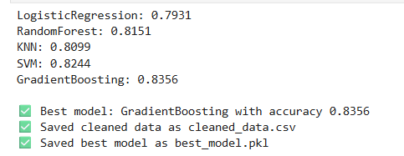
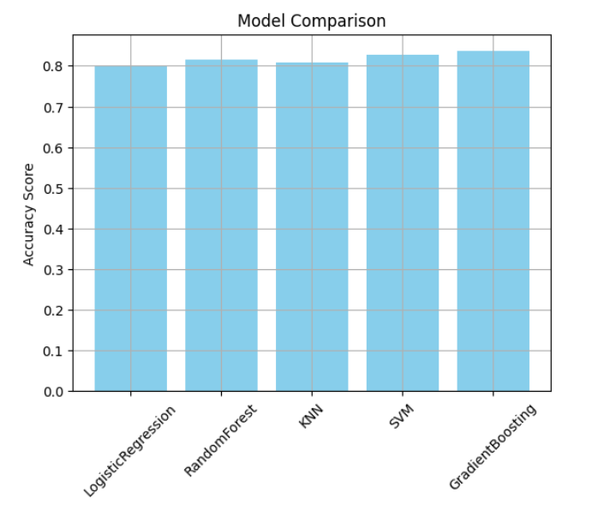
RESULT
Model Comparison Result and Graphs
Highest test accuracy achieved with Random Forest and Gradient Boosting (>80% on cleaned data).
Most impactful features for predicting higher salary class: Education level, Years of experience, Occupation, Hours worked per week.
Stream-lit UI Preview:
User-friendly web interface allows non-technical users to input their details.
Simple and Interactive: Dropdowns for inputs like job title, education level, etc., make it user-friendly for non-technical users.
Real-time Prediction: Users get instant salary predictions upon clicking a button — great for engagement and usability

Slide 13
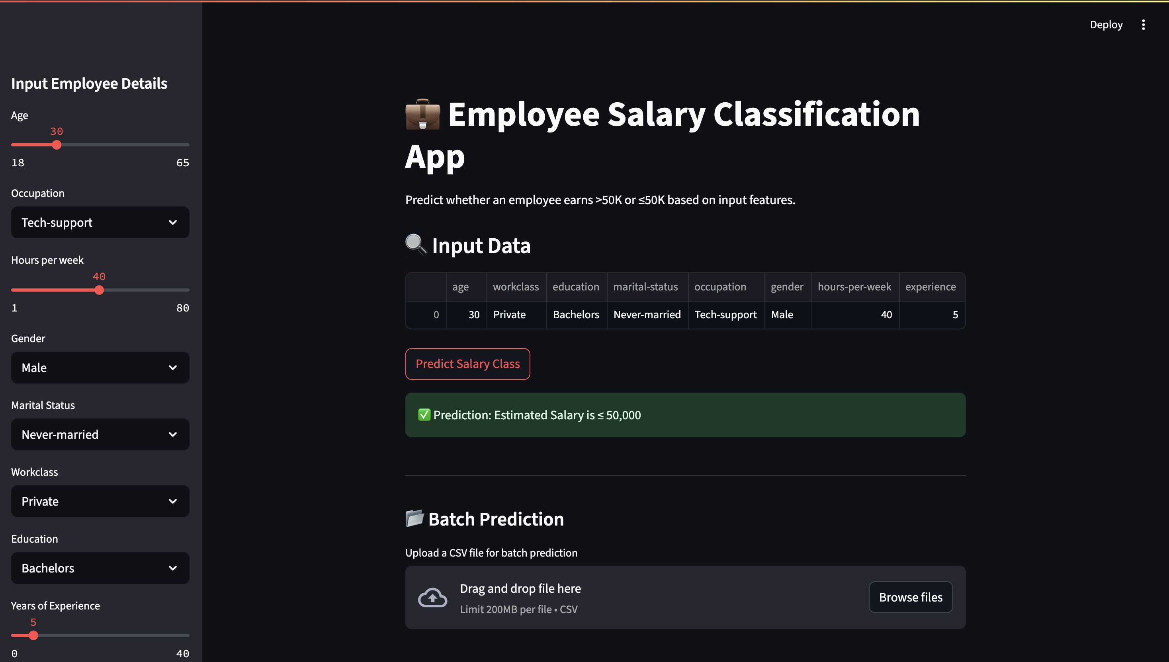
RESULT
Final Prediction Output
The input is given for a Male Tech- Supportor aged 40 having a Bachelor's Degree with 5 year of experience in urban location.
GitHub Project Link:
https://github.com/VaishnaviAgrawal03/Employee-Salary-Prediction

Slide 14
CONCLUSION
Built a robust ML classifier to categorize employees earning above or below ₹50,000 using demographic and career information.
Key drivers identified: education level, engineered experience, job type, and hours per week..
Stream-lit UI delivers interactive, real-time predictions with explainable visuals..
Impact: empowers HR with fair, data-driven compensation insights and lets individuals gauge earning potential.
Future enhancement: The model can be upgraded to predict continuous salary amounts (regression) for finer analysis, and integrated with live HR systems for greater impact..

Slide 15
REFERENCES
Scikit-learn: Machine Learning in Python. https://scikit-learn.org/stable/
Streamlit: The fastest way to build and share data apps
https://streamlit.io/
Pandas Documentation: Data analysis and manipulation tool https://pandas.pydata.org/docs/
NumPy Documentation: The fundamental package for scientific computing
https://numpy.org/doc/
Matplotlib Documentation: Visualization with Python https://matplotlib.org/stable/contents.html

Slide 16
THANK YOU

